Slide 1

COMPUTER AND SYSTEM ENGEINEERING
GRAMMARS AND LANGUAGES
POST MACHINE
AUTHOR: NATALIA RIOS
ALEJANDRO OBANDO
PROFESSOR:
JORGE RIOS
20/05/2019

Slide 2
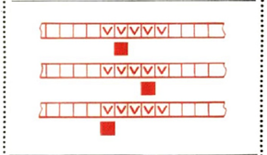
The Machine Post

Slide 3
INTRODUCTION
Emil Leon Post
Machine Post
Formal system, computational model,
it is a deterministic automaton with a tail.

Slide 4

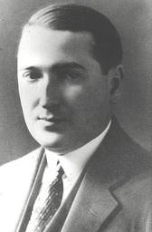
INTRODUCTION
Post developed independently of Alan Turing a mathematical model of computation that was equivalent to the M.T, also made the machine of labels, systems of post-canocico that this (uses the rewriting of chains).

Slide 5
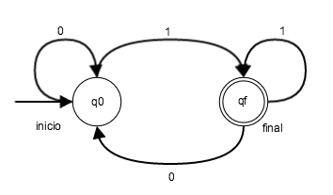
INTRODUCTION
- Tag system in 1943
Is a deterministic computational model.
whose only tape is a FIFO queue.
- TM ~ PM
- TM = Any symbol PM = Print or empty

Slide 6
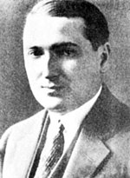
Emil Leon Post
Post (/poʊst/; February 11, 1897 – April 21, 1954) was an American mathematician and logician. He is best known for his work in the field that eventually became known as computability theory.

Slide 7
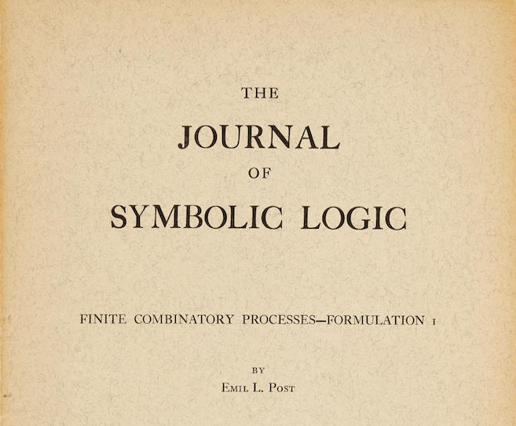
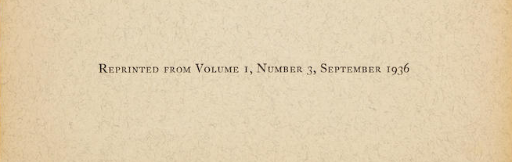
HISTORY

Slide 8
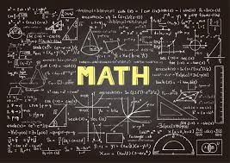
HISTORY
first algorithm concept using a mathematical model of computation.
both published their models the same year independently.

Slide 9
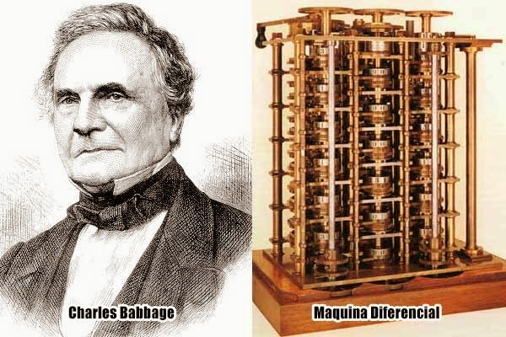
HISTORY

Slide 10
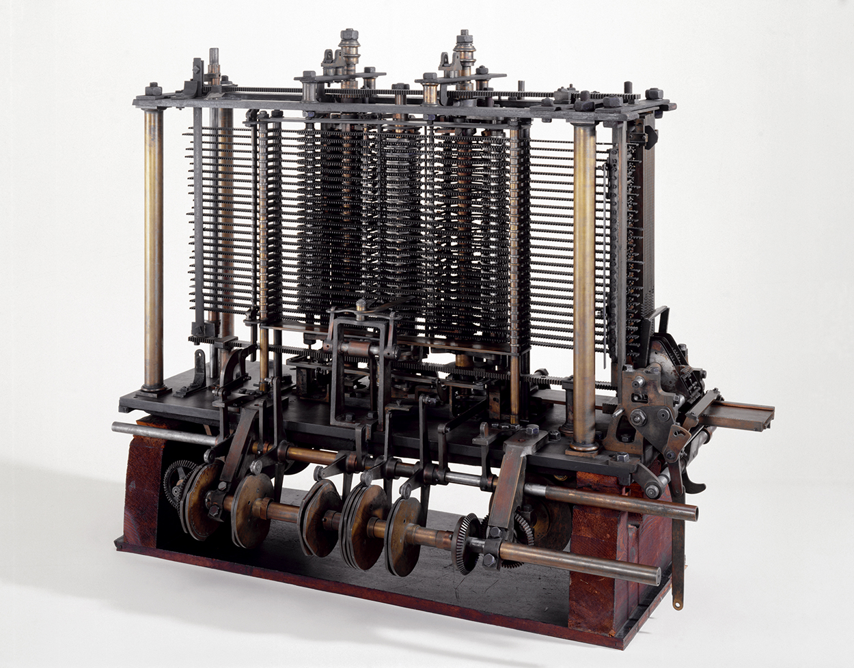
HISTORY

Slide 11
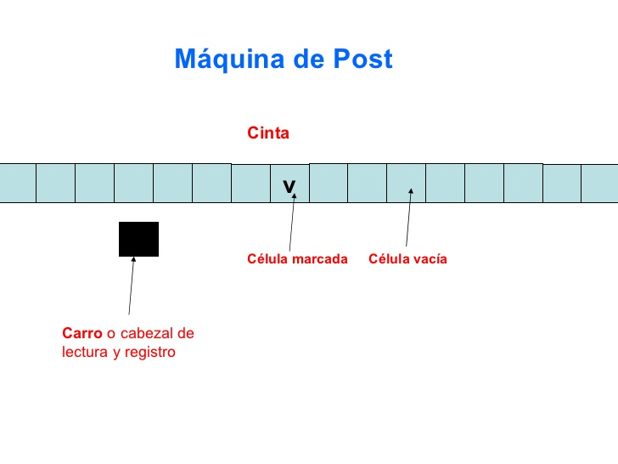
HOW DOES IT WORK?
- Binary alphabet
- Finite sequence of storage locations
- Primitive programming language

Slide 12
HOW DOES IT WORK?
- PM = { D,# } - Tape finite or infinite.
- Integer coordinates.
- Print, empty and read.

Slide 13
Machine instructions
natural numbers.
i. ---> j movement to the right
i. <--- j movement to the left i. V j print brand
Ɛ j erase Brand
j1
i. ? jump instruction, j2
if there is a mark j2 is selected otherwise j1
i. Stop

Slide 14
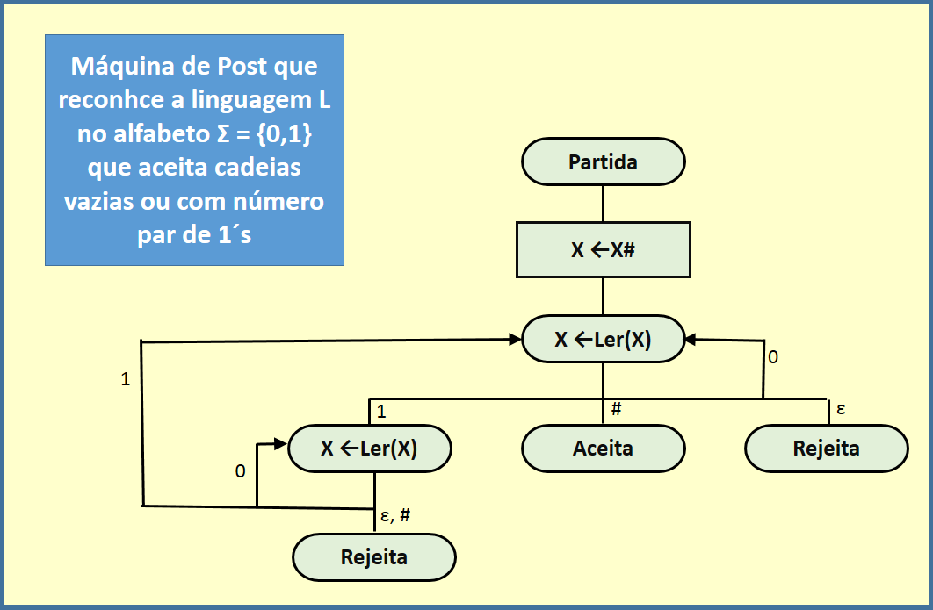
Diagram

Slide 15
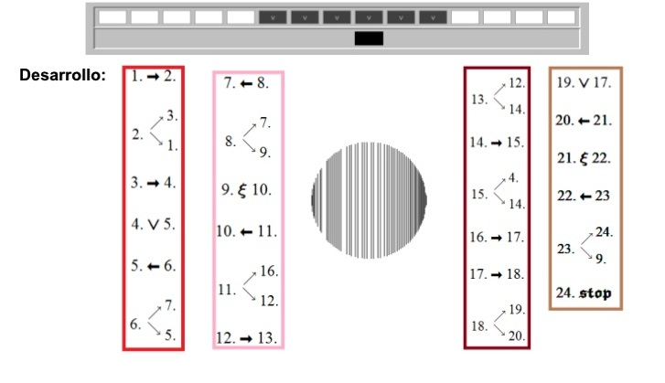
Program for the Post
machine
Example:
Sum of the first n natural numbers:

Slide 16


Program for the Post
machine
Finite list not empty.
Properties:
1) Order ( 1, 2, 3, …, k )
2) jump matches the
instruction

Slide 17
VARIANTS
Depending on: initial states or program instructions
1) Unrealizable instruction
stop without results
2) Stop results
3) infinite cycle

Slide 18
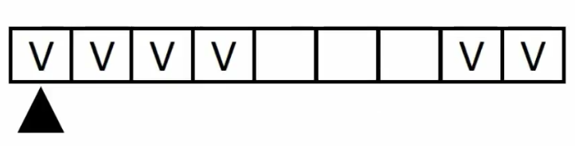
Examples
Post machine that adds two positive integers separated by a distance n on the tape
sum = 3 + 1

Slide 19
Conclusions

Slide 20
Thank you

